Slide 1

Modern Control Theory
Lecture No. 14
(Kalman Filter contd..)
Obtaining the Covariance Eqn.
Obtaining the Kalman Gain
Formulation of the Kalman Filter
Casting the Kalman Filter in a Bayesian Framework

Slide 2
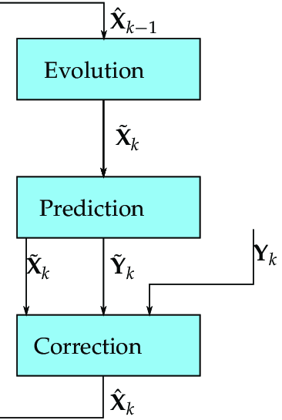
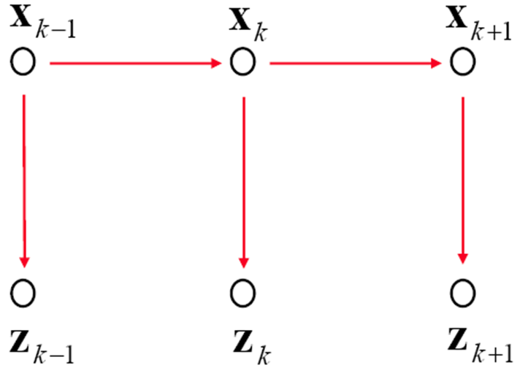


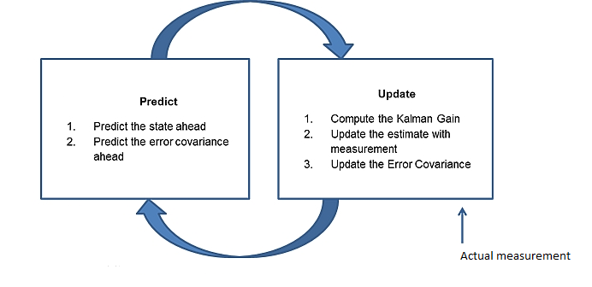




Revisiting Kalman Filter – the big picture
System Dynamics

Slide 3


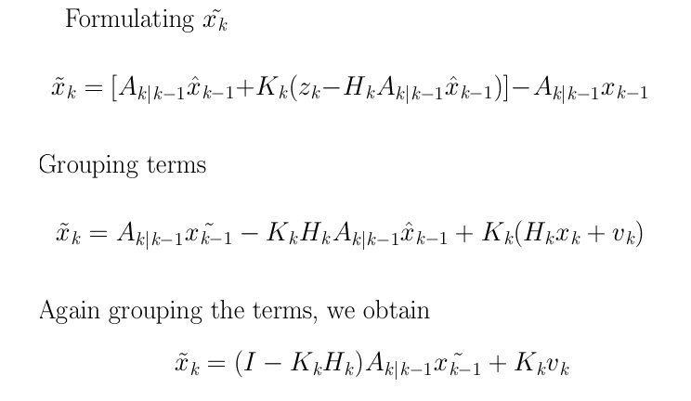
Obtaining the Covariance Matrix

Slide 4


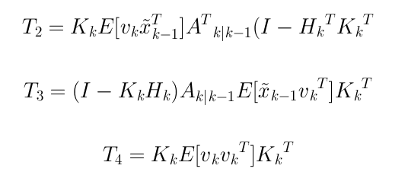
Obtaining the Covariance Matrix

Slide 5
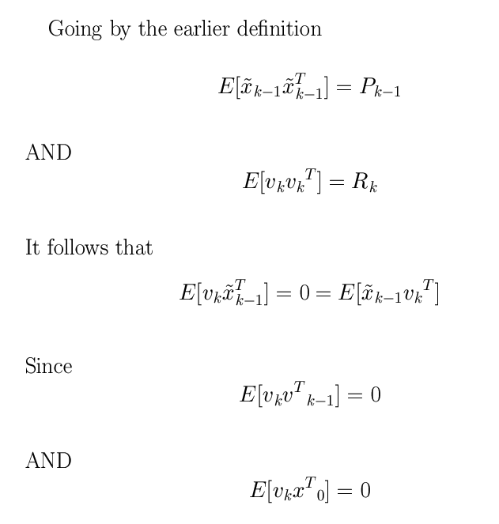

Slide 6
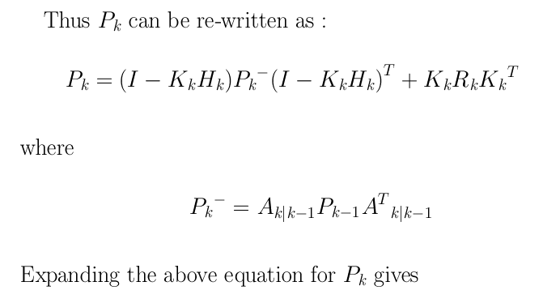


Obtaining Apriori P

Slide 7




Obtaining K

Slide 8
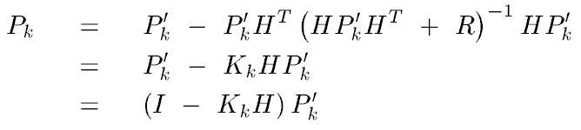
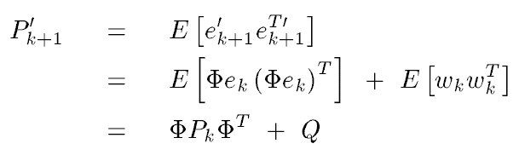
Obtaining the P Matrix

Slide 9
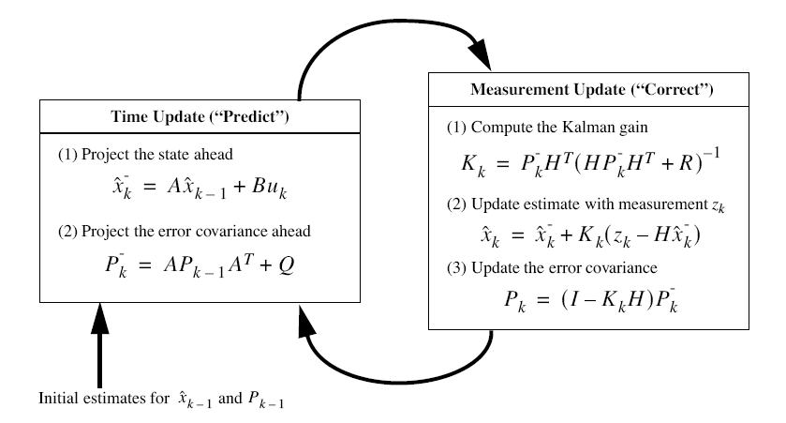
The Kalman Filter

Slide 10
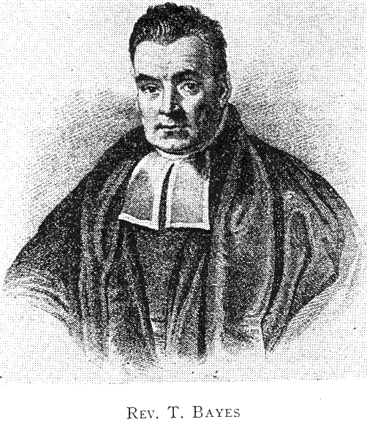
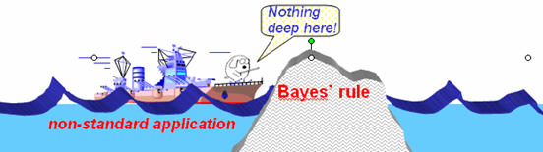
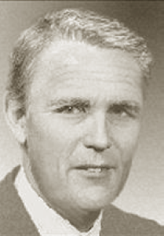

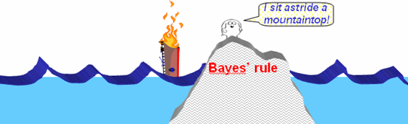
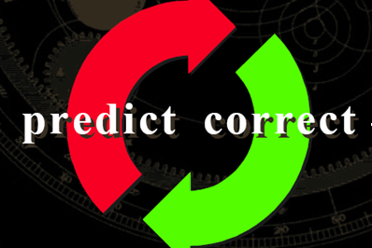

Slide 11
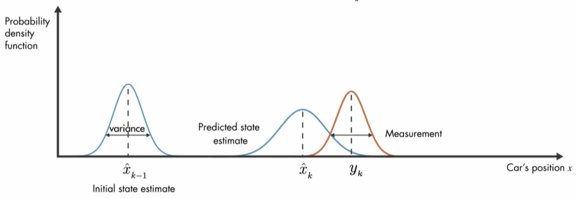
Propagation of a Conditional Density Function
Update
(k-1)+
(k)-
(k)+
Prediction
k-1
k
z(k-1)
z(k)

